Slide 1
Major Causes of Maintenance Problems: Infrastructure code smells
Damian A. Tamburri, Ph.D.

Slide 2
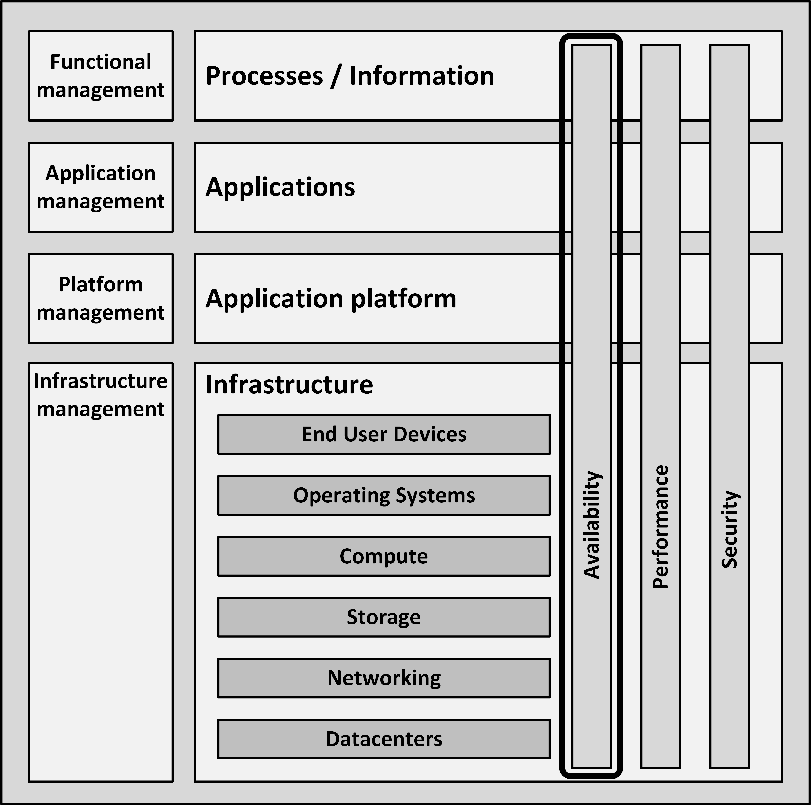
Introduction
Everyone expects their infrastructure to be available all the time
A 100% guaranteed availability of an infrastructure is impossible

Slide 3
Calculating availability
Availability can neither be calculated, nor guaranteed upfront
  It can only be reported on afterwards, when a system has run for some years
Over the years, much knowledge and experience is gained on how to design high available systems
  Failover
  Redundancy
  Structured programming
  Avoiding Single Points of Failures (SPOFs)
  Implementing systems management

Slide 4
Calculating availability
The availability of a system is usually expressed as a percentage of uptime in a given time period
  Usually one year or one month
Example for downtime expressed as a percentage per year:

Slide 5
Calculating availability
Typical requirements used in service level agreements today are 99.8% or 99.9% availability per month for a full IT system
The availability of the infrastructure must be much higher
  Typically in the range of 99.99% or higher
99.999% uptime is also known as carrier grade availability
  For one component
  Higher availability levels for a complete system are very uncommon, as they are almost impossible to reach

Slide 6
Calculating availability
It is good practice to agree on the maximum frequency of unavailability

Slide 7
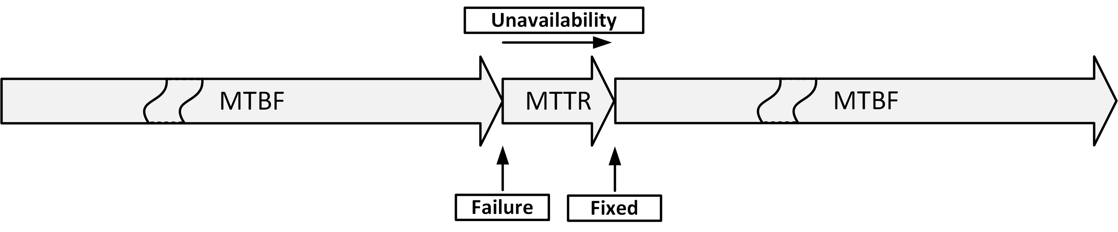
MTBF and MTTR
Mean Time Between Failures (MTBF)
  The average time that passes between failures
Mean Time To Repair (MTTR)
  The time it takes to recover from a failure

Slide 8
MTBF and MTTR
Some components have higher MTBF than others
Some typical MTB’s:

Slide 9
MTTR
MTTR can be kept low by:
  Having a service contract with the supplier
  Having spare parts on-site
  Automated redundancy and failover

Slide 10
MTTR
Steps to complete repairs:
  Notification of the fault (time before seeing an alarm message)
  Processing the alarm
  Finding the root cause of the error
  Looking up repair information
  Getting spare components from storage
  Having technician come to the datacenter with the spare component
  Physically repairing the fault
  Restarting and testing the component

Slide 11

Calculation examples
$$Availability=\frac{MTBF}{\left(MTBF+MTTR\right)}×100\%$$

Slide 12
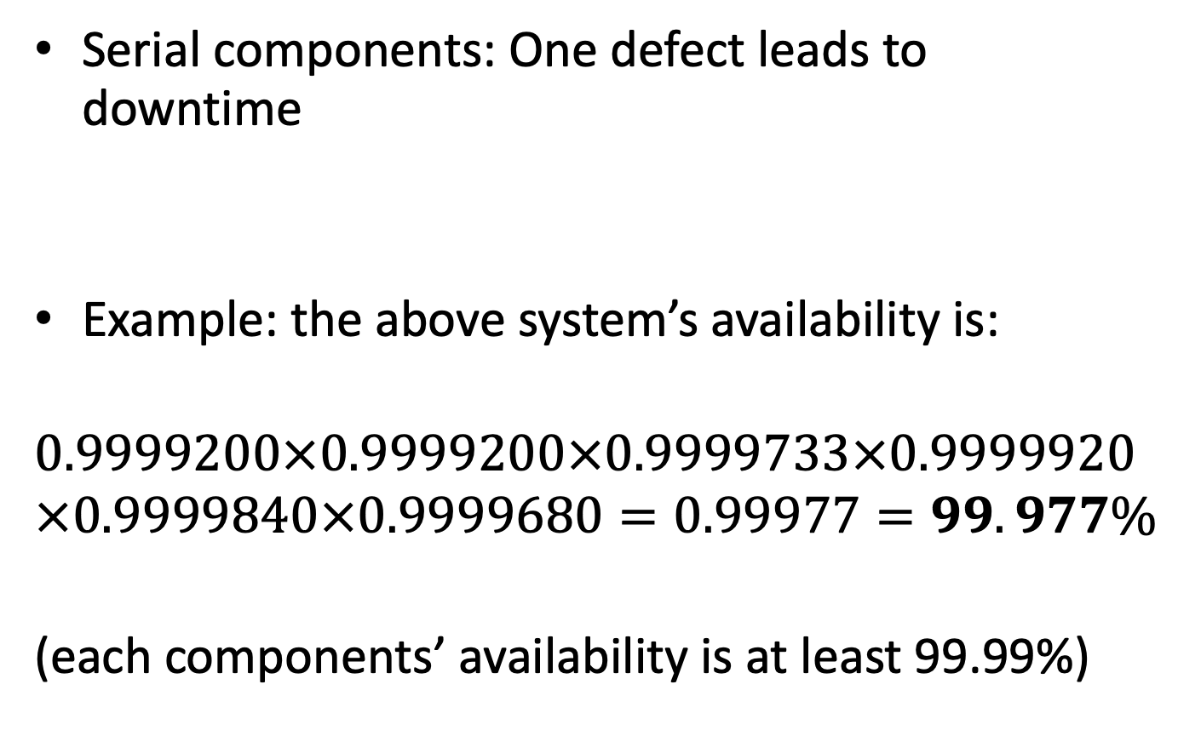
Calculation examples
Serial components: One defect leads to downtime
Example: the above system’s availability is:
$$0.9999200×0.9999200×0.9999733×0.9999920×0.9999840×0.9999680=0.99977=99.977\%$$
(each components’ availability is at least 99.99%)

Slide 13
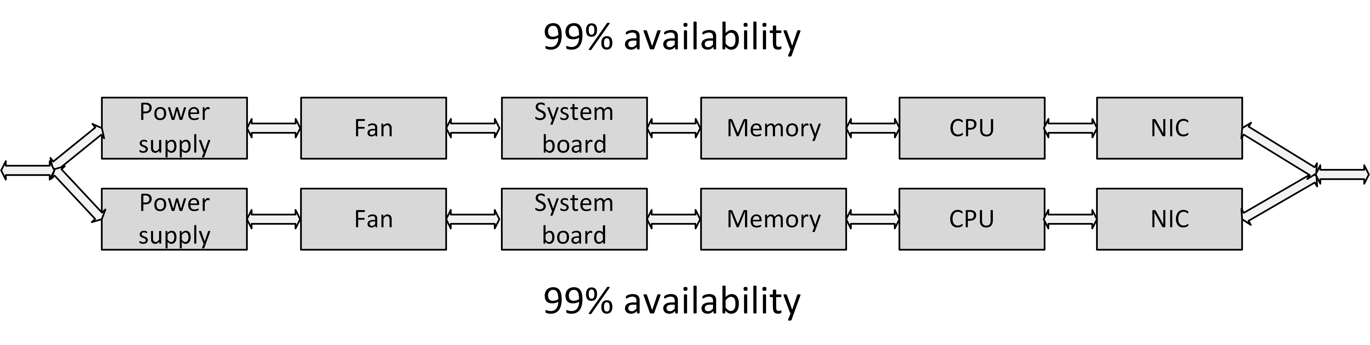
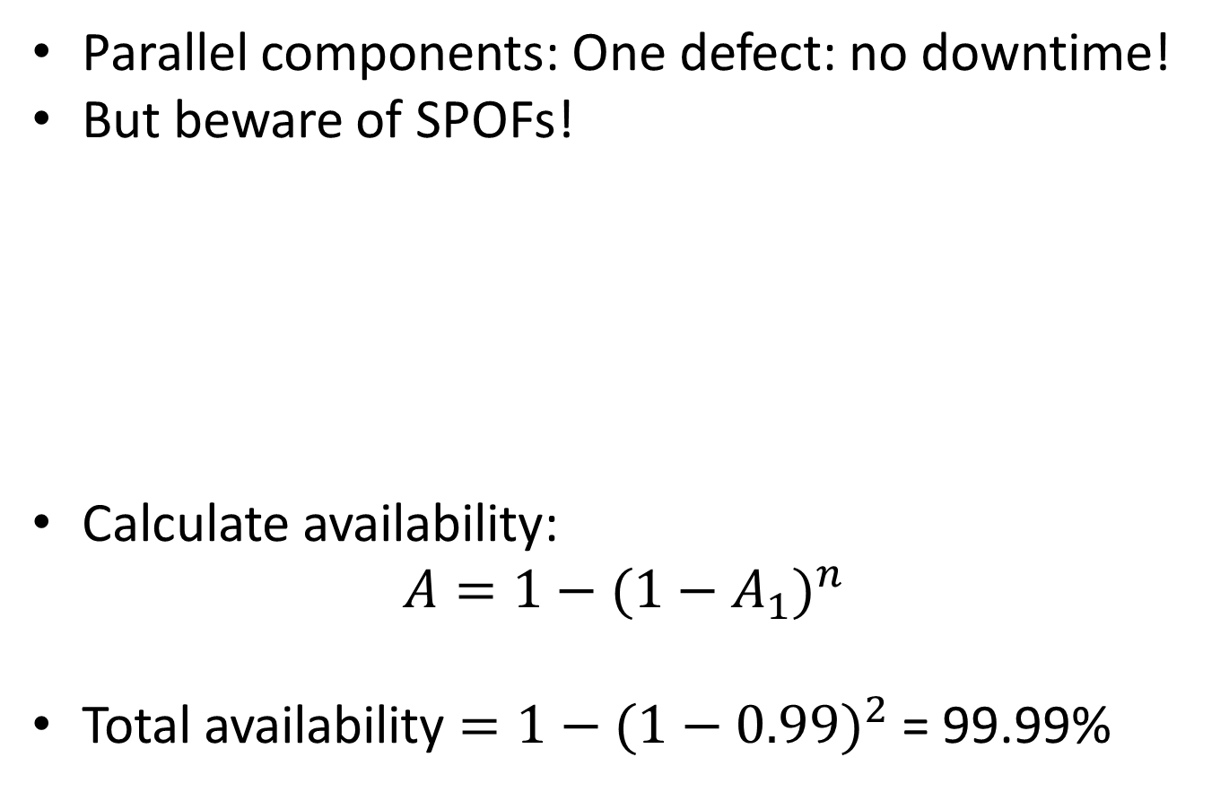
Calculation examples
Parallel components: One defect: no downtime!
But beware of SPOFs!
Calculate availability:
$$A=1−(1−A_{1})^{n}$$
Total availability $=1−(1−0.99)^{2}$ = 99.99%

Slide 14
Sources of unavailability - human errors
80% of outages impacting mission-critical services is caused by people and process issues
Examples:
    Performing a test in the production environment
    Switching off the wrong component for repair
    Swapping a good working disk in a RAID set instead of the defective one
    Restoring the wrong backup tape to production
    Accidentally removing files
      Mail folders, configuration files
    Accidentally removing database entries
      Drop table x instead of drop table y

Slide 15
Sources of unavailability - software bugs
Because of the complexity of most software it is nearly impossible (and very costly) to create bug-free software
Application software bugs can stop an entire system
Operating systems are software too
  Operating systems containing bugs can lead to corrupted file systems, network failures, or other sources of unavailability

Slide 16
Sources of unavailability - planned maintenance
Sometimes needed to perform systems management tasks:
  Upgrading hardware or software
  Implementing software changes
  Migrating data
  Creation of backups
Should only be performed on parts of the infrastructure where other parts keep serving clients
During planned maintenance the system is more vulnerable to downtime than under normal circumstances
  A temporary SPOF could be introduced
  Systems managers could make mistakes

Slide 17
Sources of unavailability - physical defects
Everything breaks down eventually
Mechanical parts are most likely to break first
Examples:
  Fans for cooling equipment usually break because of dust in the bearings
  Disk drives contain moving parts
  Tapes are very vulnerable to defects as the tape is spun on and off the reels all the time
  Tape drives contain very sensitive pieces of mechanics that can break easily

Slide 18
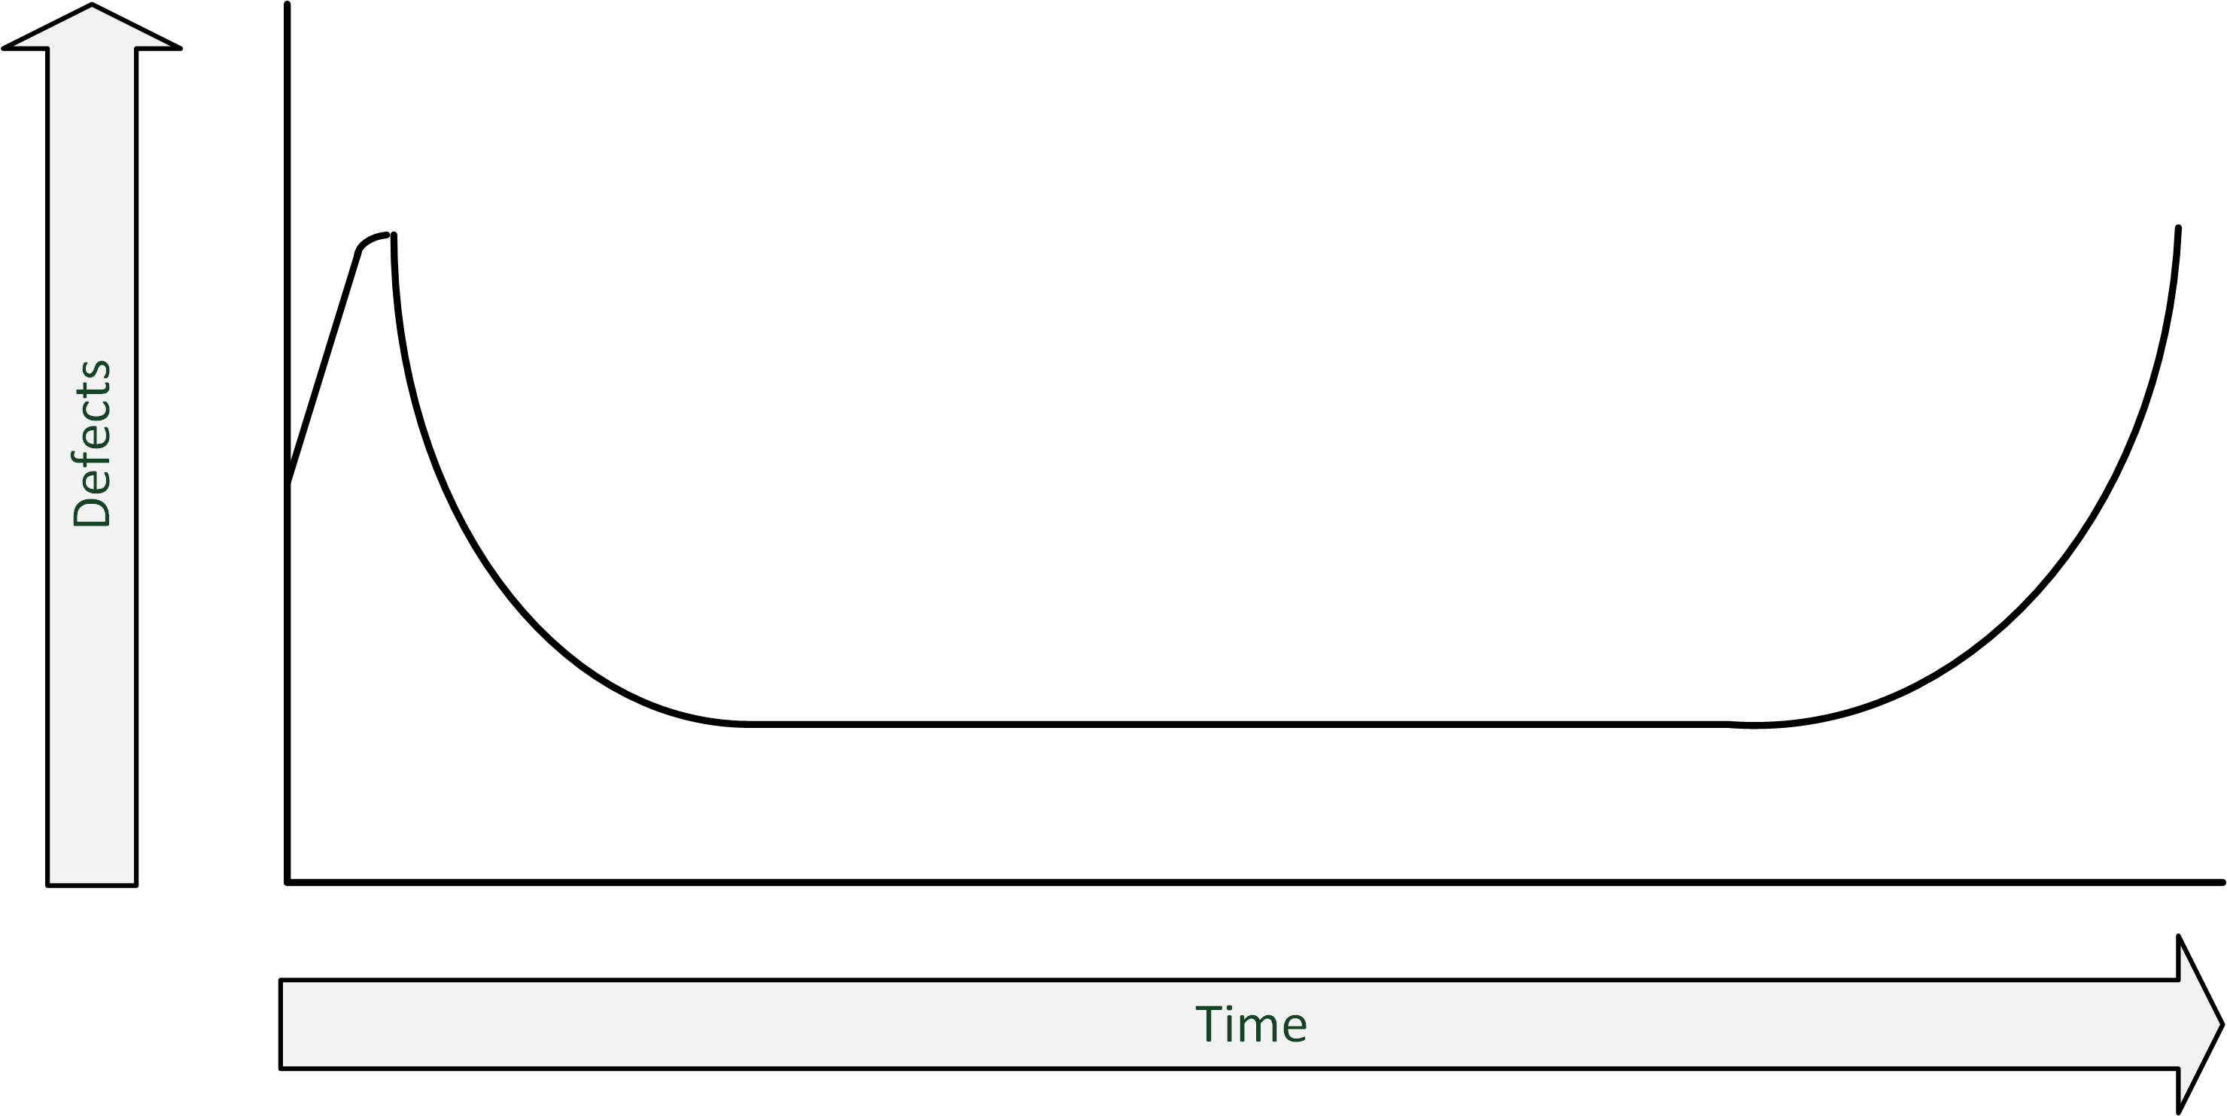
Sources of unavailability - bathtub curve
A component failure is most likely when the component is new
When a component still works after the first month, it is likely that it will continue working without failure until the end of its life

Slide 19
Sources of unavailability - environmental issues
Environmental issues can cause downtime:
  Failing facilities
    Power
    Cooling
  Disasters
    Fire
    Earthquakes
    Flooding

Slide 20
Sources of unavailability - complexity of the infrastructure
Adding more components to an overall system design can undermine high availability
  Even if the extra components are implemented to achieve high availability
Complex systems
  Have more potential points of failure
  Are more difficult to implement correctly
  Are harder to manage
Sometimes it is better to just have an extra spare system in the closet than to use complex redundant systems

Slide 21
Redundancy
Redundancy is the duplication of critical components in a single system, to avoid a single point of failure (SPOF)
Examples:
  A single component having two power supplies; if one fails, the other takes over
  Dual networking interfaces
  Redundant cabling

Slide 22
Failover
Failover is the (semi)automatic switch-over to a standby system or component
Examples:
  Windows Server failover clustering
  VMware High Availability
  Oracle Real Application Cluster (RAC) database

Slide 23
Fallback
Fallback is the manual switchover to an identical standby computer system in a different location
Typically used for disaster recovery
Three basic forms of fallback solutions:
  Hot site
  Cold site
  Warm site

Slide 24
Fallback – hot site
A hot site is
  A fully configured fallback datacentre
  Fully equipped with power and cooling
  Applications are installed on the servers
  Data is kept up-to-date to fully mirror the production system
Requires constant maintenance of the hardware, software, data, and applications to be sure the site accurately mirrors the state of the production site at all times

Slide 25
Fallback - cold site
Is ready for equipment to be brought in during an emergency, but no computer hardware is available at the site
Applications will need to be installed and current data fully restored from backups
If an organization has very little budget for a fallback site, a cold site may be better than nothing

Slide 26
Fallback - warm site
A computer facility readily available with power, cooling, and computers, but the applications may not be installed or configured
A mix between a hot site and cold site
Applications and data must be restored from backup media and tested
  This typically takes a day

Slide 27
Business Continuity
An IT disaster is defined as an irreparable problem in a datacenter, making the datacenter unusable
Natural disasters:
  Floods
  Hurricanes
  Tornadoes
  Earthquakes
Manmade disasters:
  Hazardous material spills
  Infrastructure failure
  Bio-terrorism

Slide 28
Business Continuity
In case of a disaster, the infrastructure could become unavailable, in some cases for a longer period of time
Business Continuity Management includes:
  IT
  Managing business processes
  Availability of people and work places in disaster situations
Disaster recovery planning (DRP) contains a set of measures to take in case of a disaster, when (parts of) the IT infrastructure must be accommodated in an alternative location

Slide 29
RTO and RPO
RTO and RPO are objectives in case of a disaster
Recovery Time Objective (RTO)
  The maximum duration of time within which a business process must be restored after a disaster, in order to avoid unacceptable consequences (like bankruptcy)

Slide 30
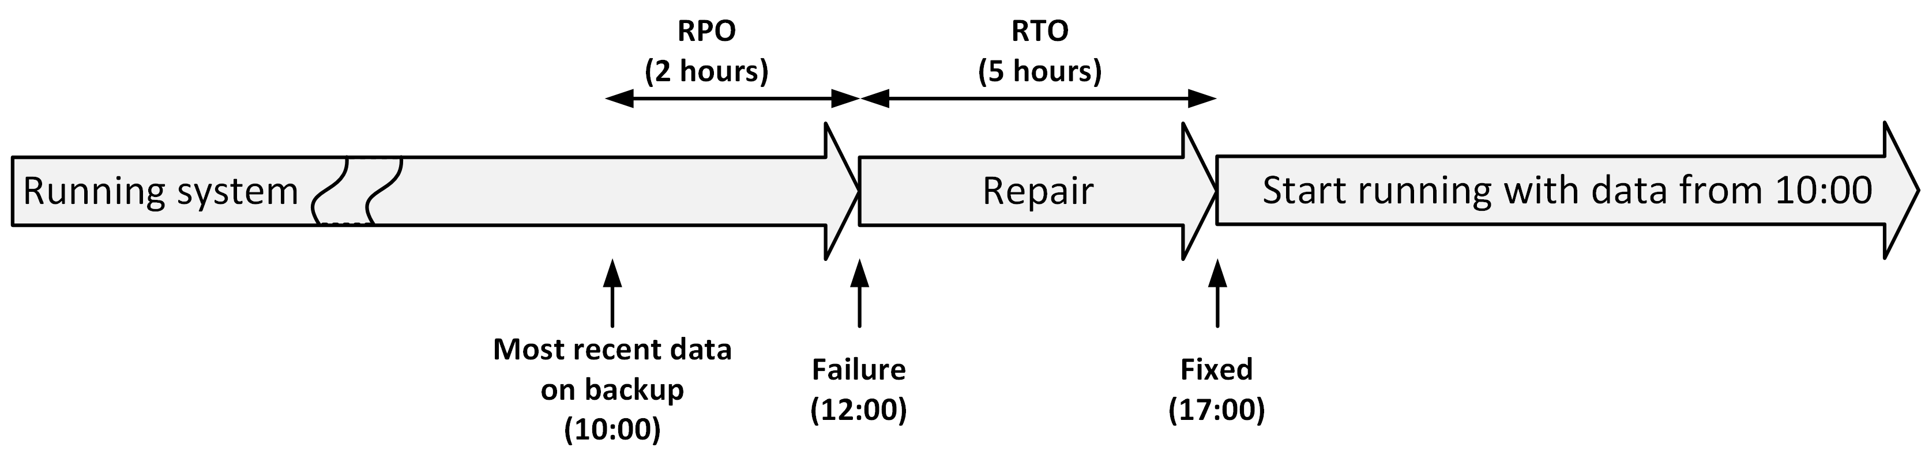
RTO and RPO
Recovery Point Objective (RPO)
  The point in time to which data must be recovered considering some "acceptable loss" in a disaster situation
RTO and RPO are individual objectives
  They are not related

Slide 31
What can we do to fix/evolve it?
Mitigate Human Error
Employ AIOps
  High Observability Infrastructures
  Infrastructure-as-code Smells!

Slide 32
What can we do to fix/evolve it?
Mitigate Human Error
Employ AIOps
  High Observability Infrastructures
  Infrastructure-as-code Smells!

Slide 33
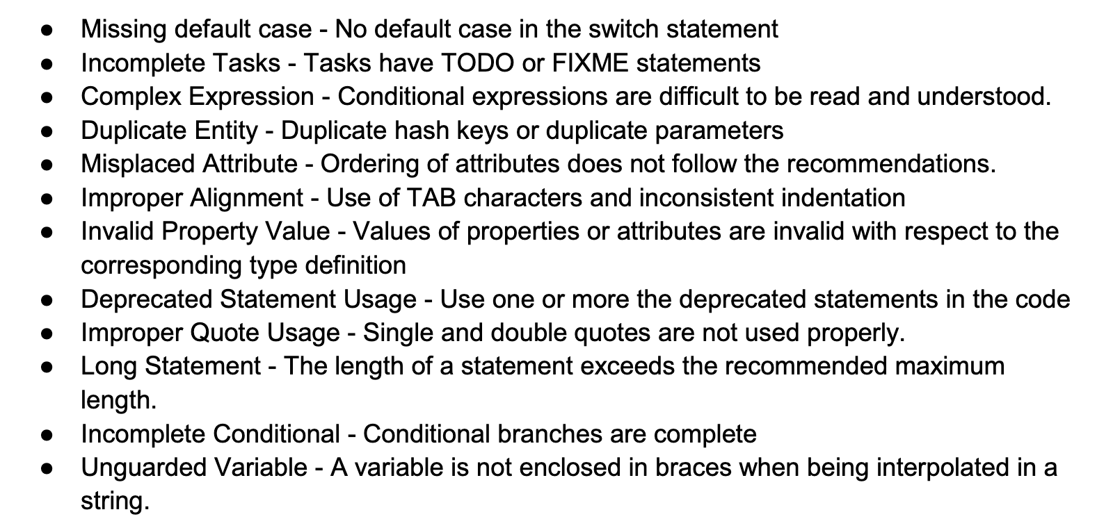


Design Structure Smells*
* Tushar Sharma, Marios Fragkoulis, and Diomidis Spinellis. 2016. Does your
configuration code smell?. In Proceedings of the 13th International Conference on
Mining Software Repositories (MSR '16). ACM, New York, NY, USA, 189-200.
*mostly for Chef & Puppet

Slide 34
How do we fix it (automatically)?
…

Slide 35


Slide 36
Security Smells*
*Rahman, Akond, Chris Parnin, and Laurie Williams. "The seven sins: security smells in infrastructure as code scripts." Proceedings of the 41st International Conference on Software Engineering. IEEE Press, 2019.

Slide 37
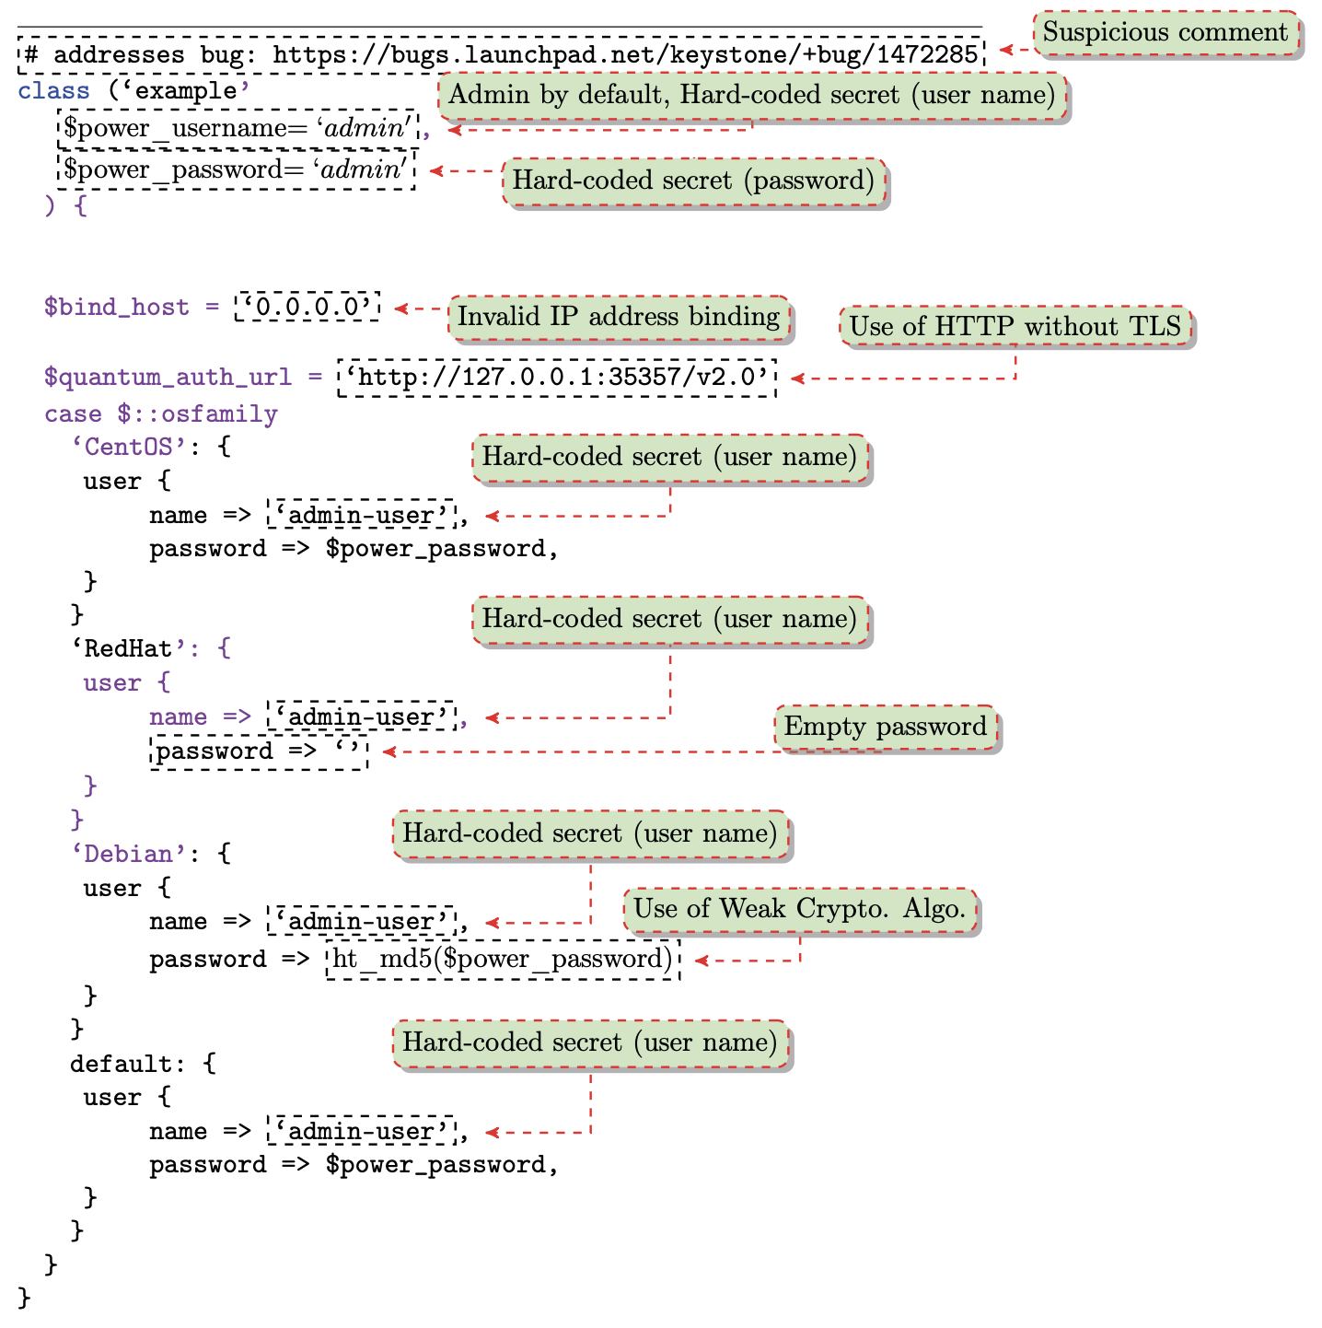

Slide 38
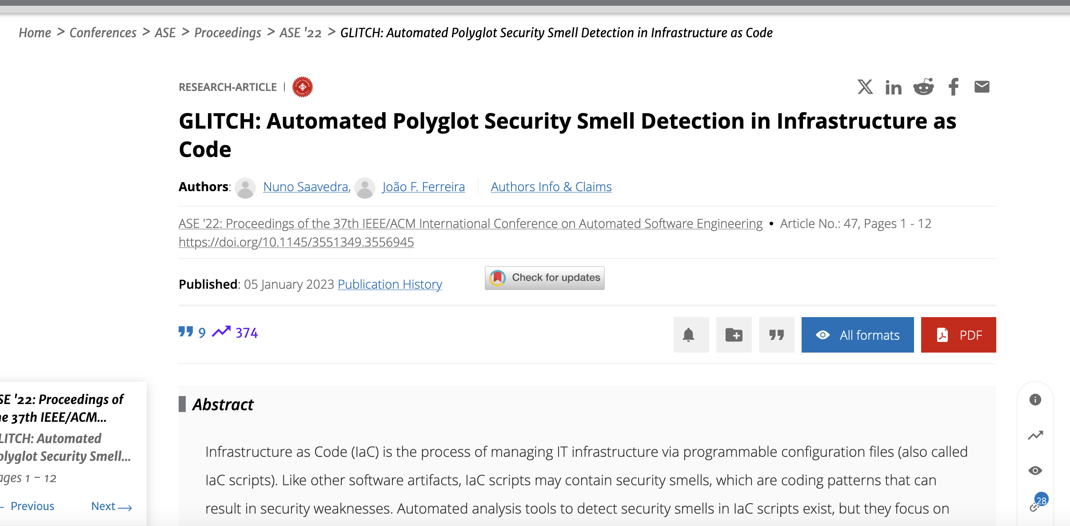
How do we fix it (automatically)?

Slide 39
Other Technical Smells*
* Schwarz, Julian, Andreas Steffens, and Horst Lichter. "Code Smells in Infrastructure as Code." 2018 11th International Conference on the Quality of Information and Communications Technology (QUATIC). IEEE, 2018.

Slide 40
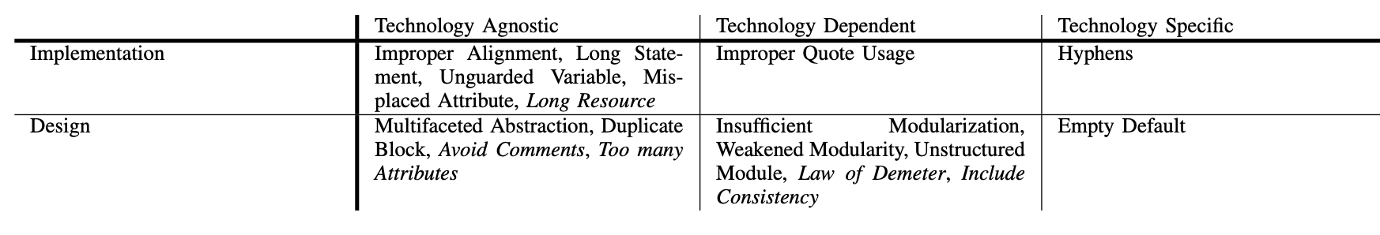

Slide 41
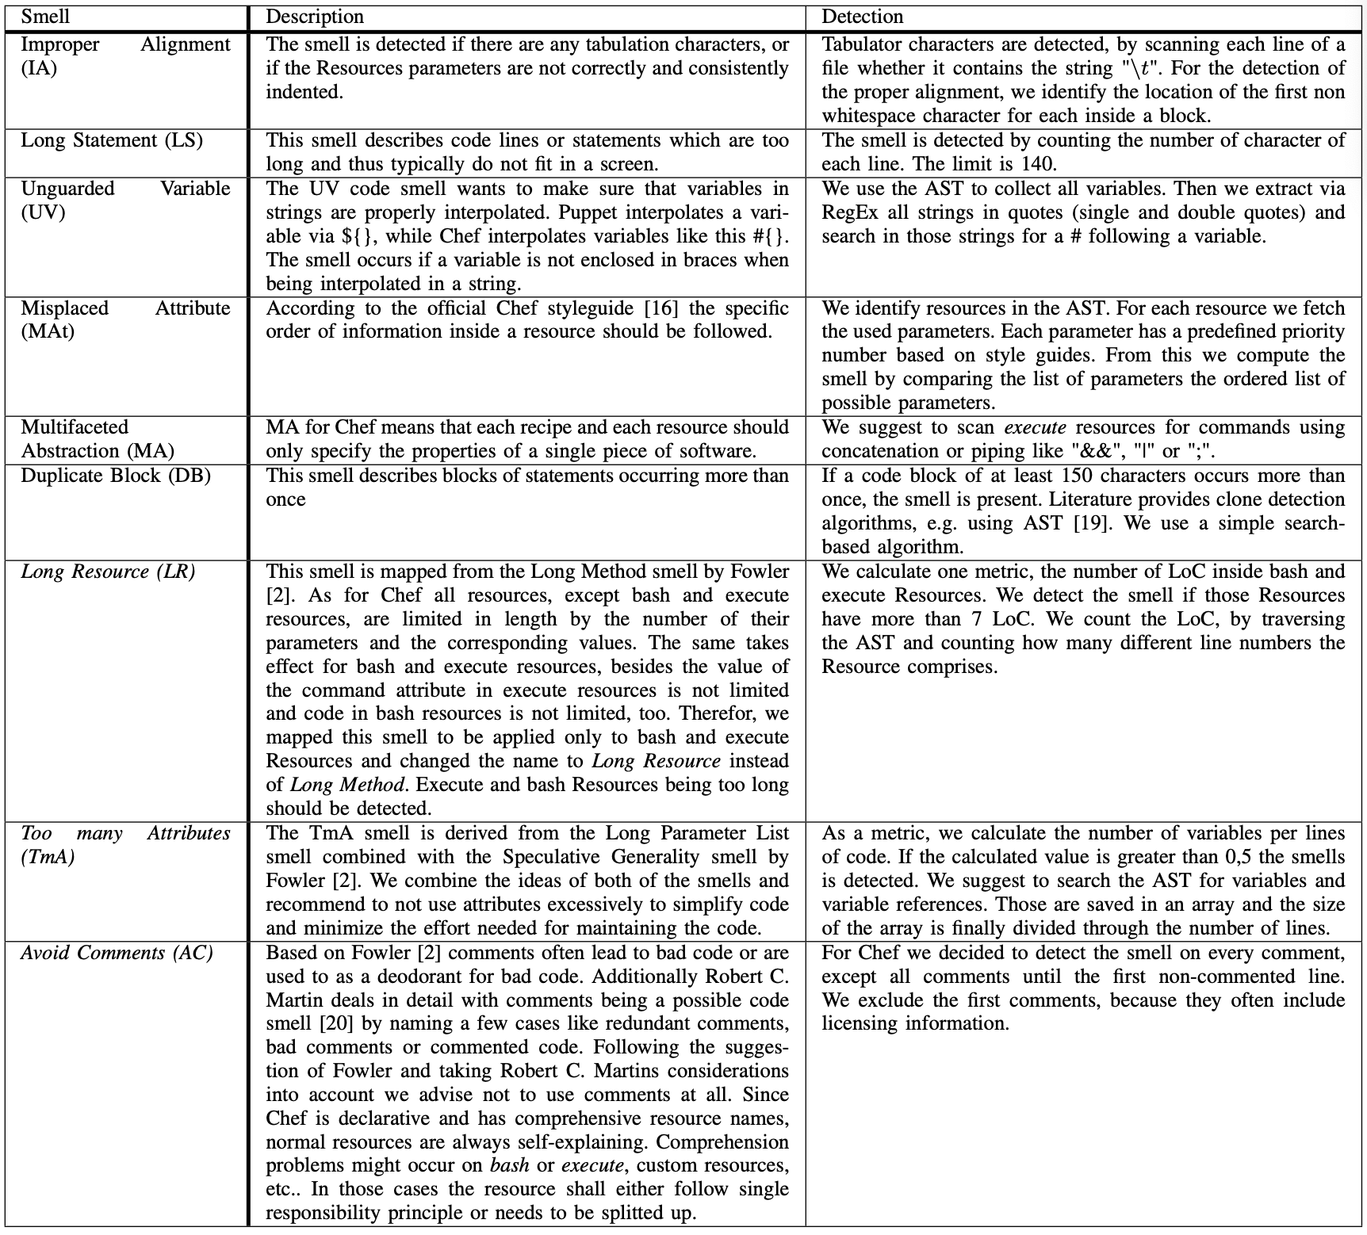

Slide 42
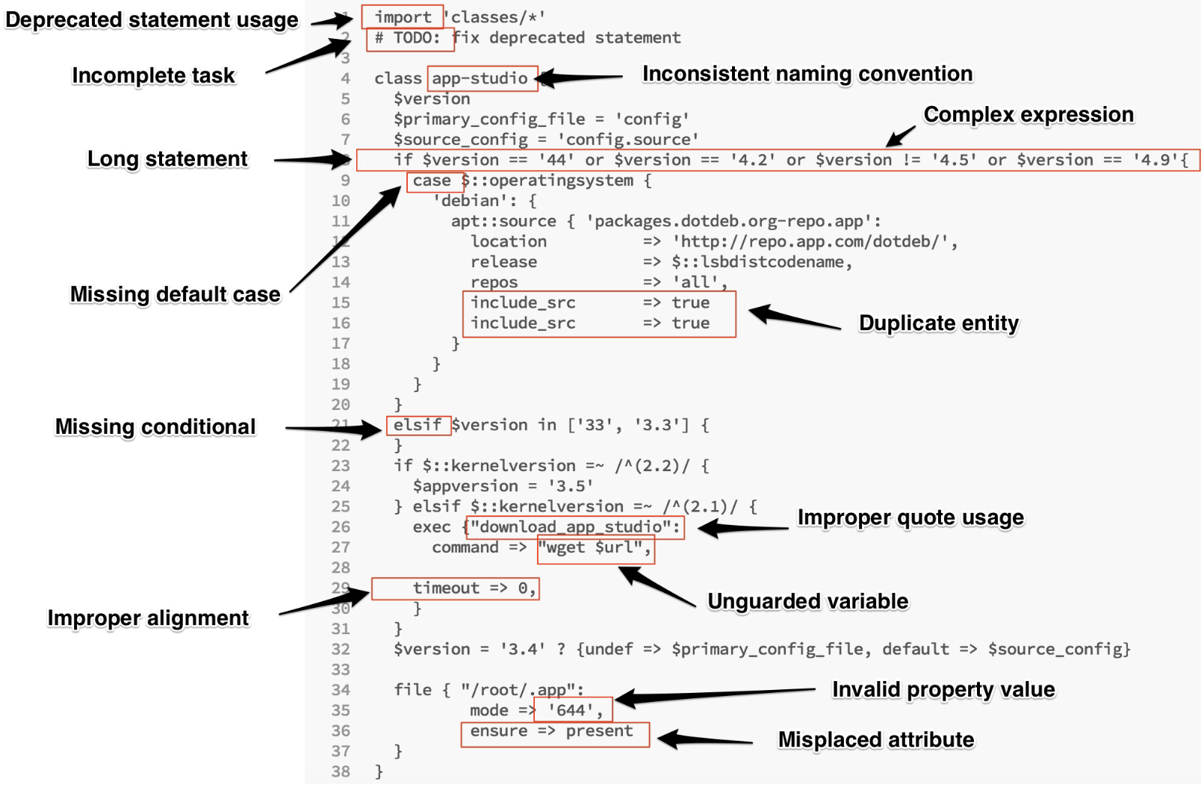

Slide 43
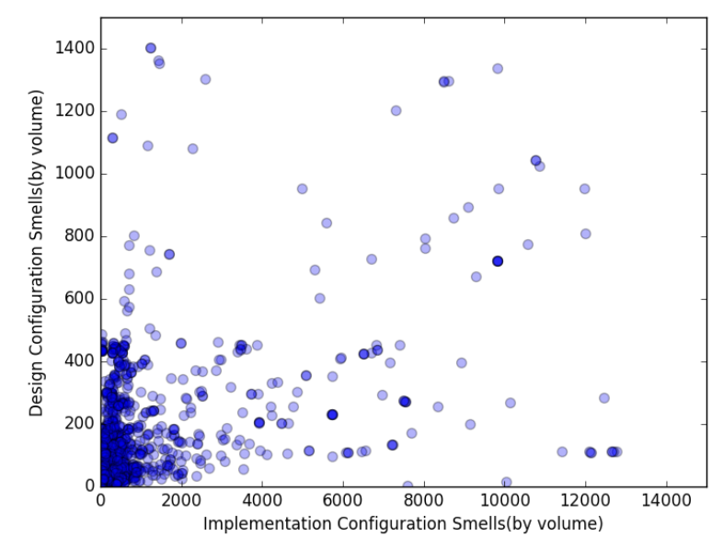
Co-occurrence between implementation and design configuration smells

Slide 44
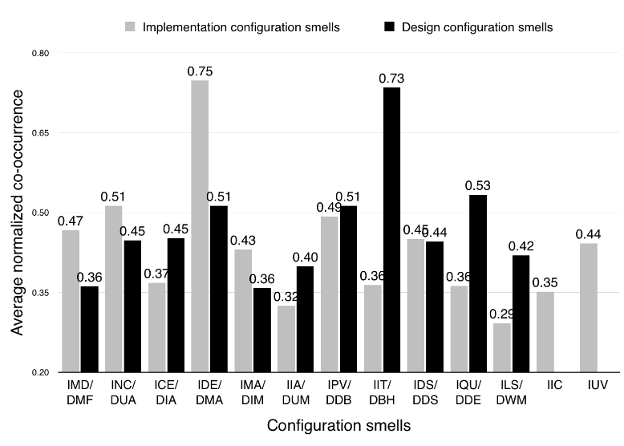
Average co-occurrence (intra-category) for implementation and design configuration smells

Slide 45
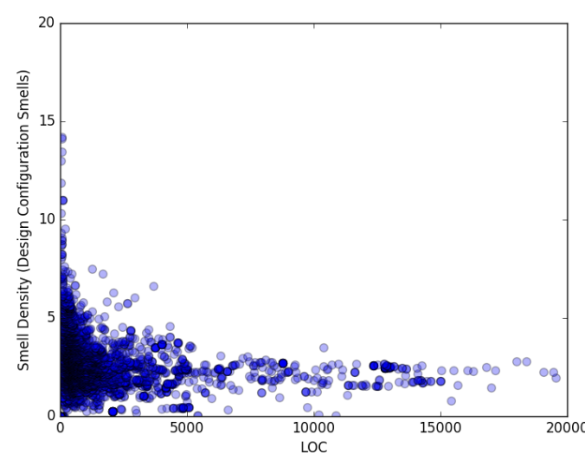
Smell density for design configuration smells against lines of code

Slide 46
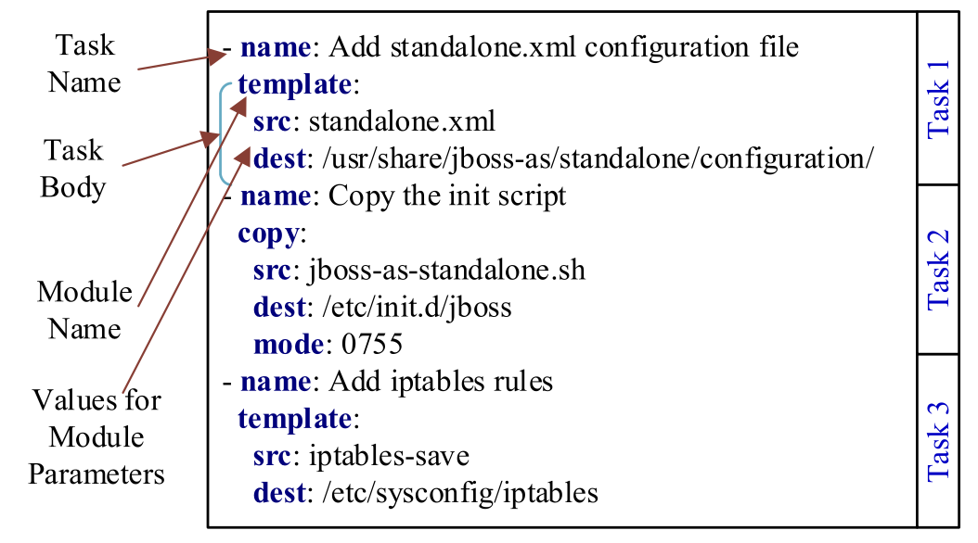
Using machine-learning to detect linguistic inconsistencies between code and natural language descriptions in infrastructure-as-code

Slide 47
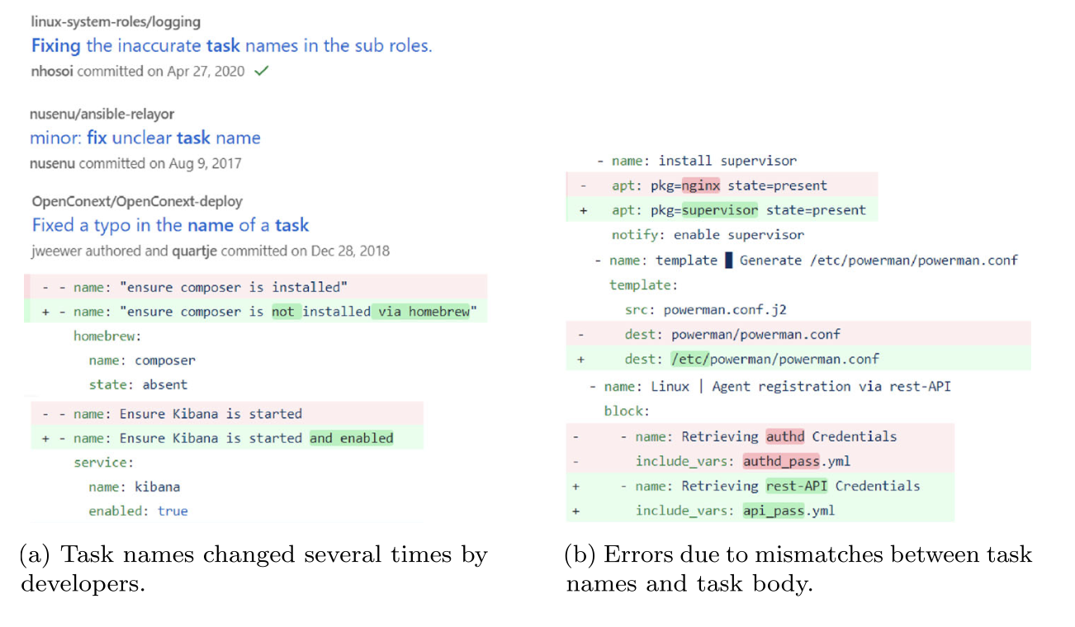
Examples of inconsistent task names and bodies in IaC

Slide 48
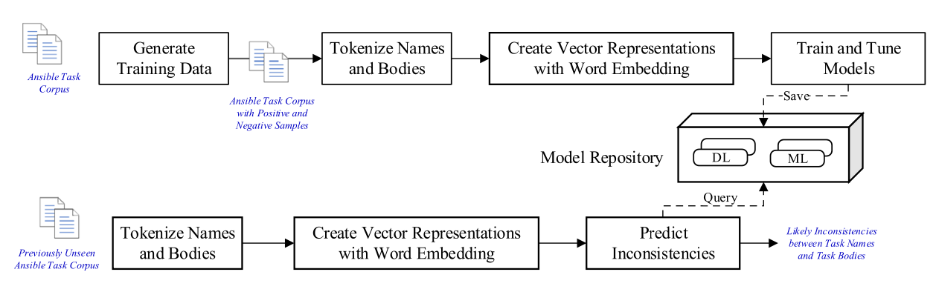
the FindICI approach*
* Borovits, N., Kumara, I., Di Nucci, D. et al. FindICI: Using machine learning to detect linguistic inconsistencies between code and natural language descriptions in infrastructure-as-code. Empir Software Eng 27, 178 (2022). https://doi.org/10.1007/s10664-022-10215-5

Slide 49
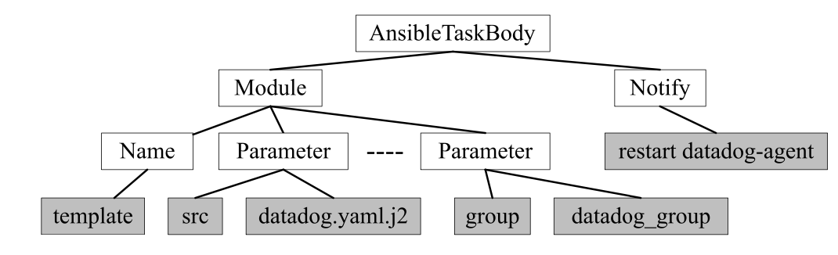
AST model for a task using template module

Slide 50
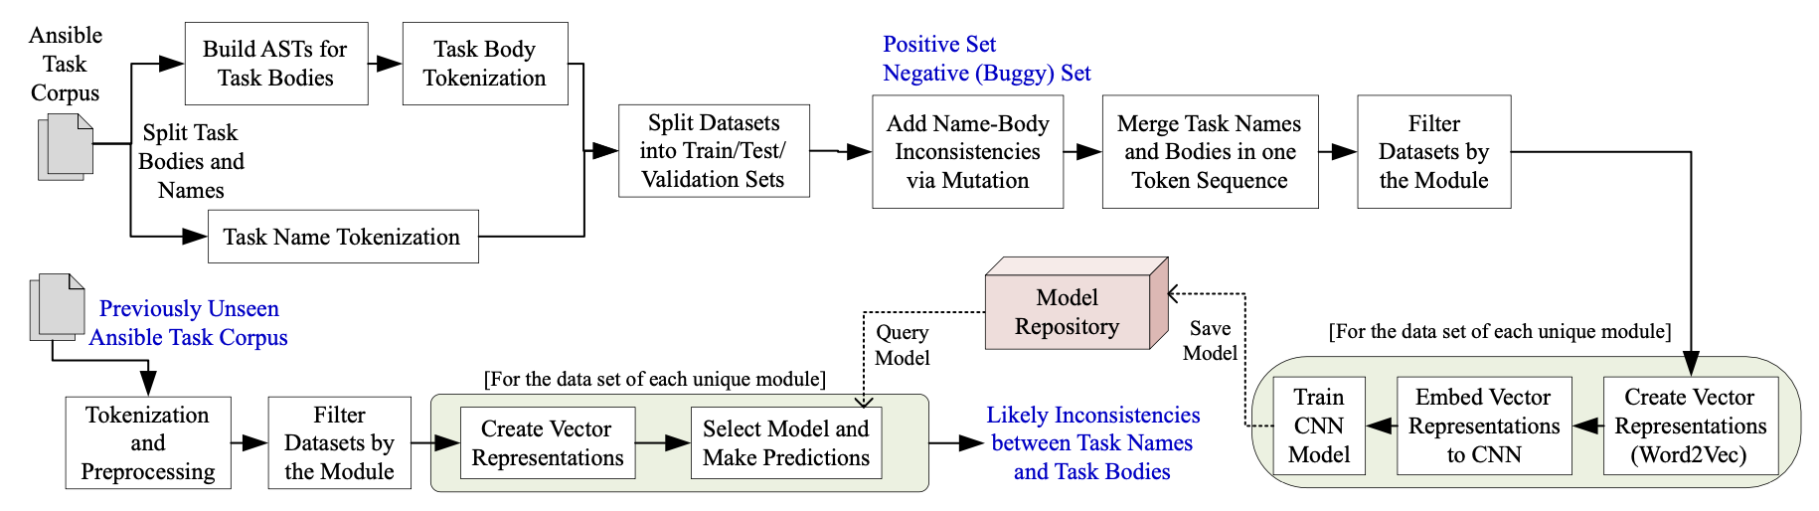
The DeepIaC* Approach
* Nemania Borovits, Indika Kumara, Parvathy Krishnan, Stefano Dalla Palma, Dario Di Nucci, Fabio Palomba, Damian A. Tamburri, and Willem-Jan van den Heuvel. 2020. DeepIaC: deep learning-based linguistic anti-pattern detection in IaC. In Proceedings of the 4th ACM SIGSOFT International Workshop on Machine-Learning Techniques for Software-Quality Evaluation (MaLTeSQuE 2020). Association for Computing Machinery, New York, NY, USA, 7–12. https://doi.org/10.1145/3416505.3423564

Slide 51
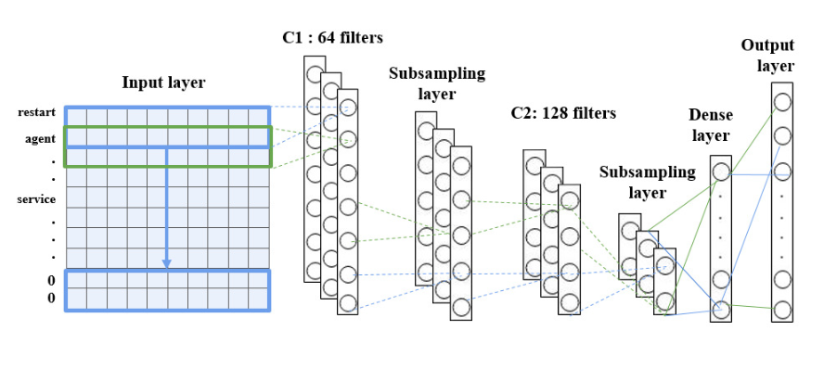
A CNN-based way

Slide 52


Slide 53



Many-eyes Phenomena in SM&E?

Slide 54
Wrapping it all up
From a maintenance perspective, infrastructure code is still code
  Subject to smells, bugs and more!
  Most of it is still unknown
Code smells & their detection/avoidance is a reasonable start!
Co-evolution of smells counts offer incredible motivational basis to further our work into the matter!

Slide 55

Questions?

